Slide 1
De lege ferenda possibilities in the field of environmental migration
De lege ferenda possibilities in the field of environmental migration

Slide 2
De lege ferenda possibilities in the field of environmental migration
Věra Honusková

Slide 3
The road ahead
Is there a room in the existing protection statuses to protect environmental migrants?
Is there a will to create a new treaty instrument or to complement some of the existing ones?
Please think about where you see the most likely developments in this area. What, if anything, is missing for you to reach a conclusion?

Slide 4
The road ahead
Interpretation?
similarly women, SOGI refugees
Expanding the grounds in the definition of refugee
new reason in the convention?
Creating a new (probably regional) status?
similarly to subsidiary protection in the EU law (or gender – e.g. in the Czech laws)
Creating a protocol to one of the existing conventions?
Similarly to 1967 Protocol to 1951 Convention (although it did not change the definition)
Creating a new convention at the universal level?

Slide 5
Saving through interpretation?
SOGI refugees/gender in the EU law as an example.

Slide 6
Sexual orientation – EU law Qualification directive, art. 10 (1)

Slide 7
Sexual orientation - CJEU
Court of Justice of the EU in the case C‑199/12-C‑201/12 case X, Y and Z (2013)
Is the sexual orientation a reason for protection?
Is criminalisation enough?
Can a person be expected to conceal their orientation from everyone in their country of origin in order to avoid persecution? („hide in a closet“)
Credibility assessment – „proof of homosexuality“? How to prove?
Court of Justice of the EU in the case C‑148/13-C‑150/13 case A, B and C (2014)
Tests to establish homosexuality precluded
Court of Justice of the EU in the case C‑473/16 case F (2018)
Psychologist´s expert report precluded

Slide 8
Environmental migrants (R. Stojanov et al, 2014)
1. Environmentally motivated migrants - who voluntarily leave their home due to environmental threats (that do not threaten their life) …. they want to leave, can choose whether and when,
2. Environmentally displaced persons (EDP) - who leave their home under duress because of a threat to their life, health or livelihood, and can be divided into gradual and rapid, … must leave
slow onset events – „hesitating“ EDP … (cannot choose whether, can choose when)
rapid onset events – „immediate“ EDPs (cannot choose whether, cannot choose when) = true environmental migrants, forced environmental migrants,
3. Planned relocation and resettlement - who leave forcibly and usually in an organised manner in connection with the planned development of the area in which they live. …have to leave on the basis of external causes associated with a fundamental deterioration in the ability of the environment to sustain life)

Slide 9
A new convention?
New York declaration on refugees and migrants (2016) – soft law
Basis for
Global Compact on Refugees (soft law)
Global Compact for Safe, Orderly and Regular Migration (soft law)
...states do not have the will to adopt a binding instrument...?

Slide 10
How can science think?
International Law Commission: Draft articles on the protection of persons in the event of disasters, 2016

Slide 11
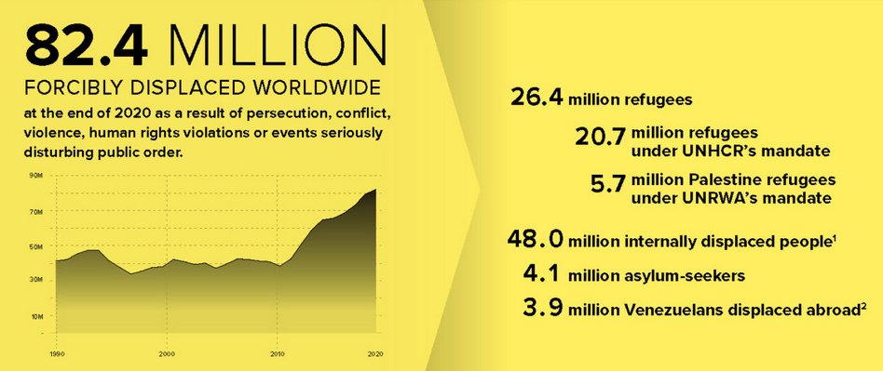

Slide 12
The road ahead
...in migration law, we leave aside the dynamics of the process and deal only with the consequences.
mitigation in the sense of avoiding mitigation, adaptation as coping with the impacts of a changing climate
mitigation
adaptation
migration

Slide 13
Thank you for your attention!

