Slide 1
Shaping the course
What do you expect?
What do you offer?
- What do I expect?
- What do I offer?
…..
…..
Attention, active participation
Interactive course with human rights background
Basic orientation, focus on environmental migrants
3–4 coffees with guests (Wed. 9-10)? Online coffees?

Slide 2
Lecturer
graduated from PF UK (Ph.D. dissertation: Definition of a Refugee in Contemporary International Law),
work experience in NGOs - representation of migrants, refugees; research project on the attitude of foreign police towards foreigners,
work experience in a law firm and with the Ministry of the Interior (Commission for Decision-Making in Foreigners' Matters),
member of the Odysseus network (European network of experts in asylum and migration law),
articles on refugee or migration law, co-author of the Annotated Refugee Act.

Slide 3
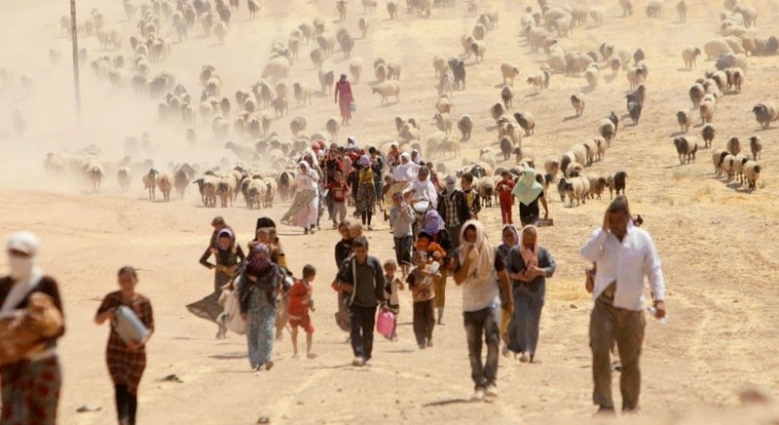
…future refugees?
Věra Honusková, honuskov@prf.cuni.cz

Slide 4
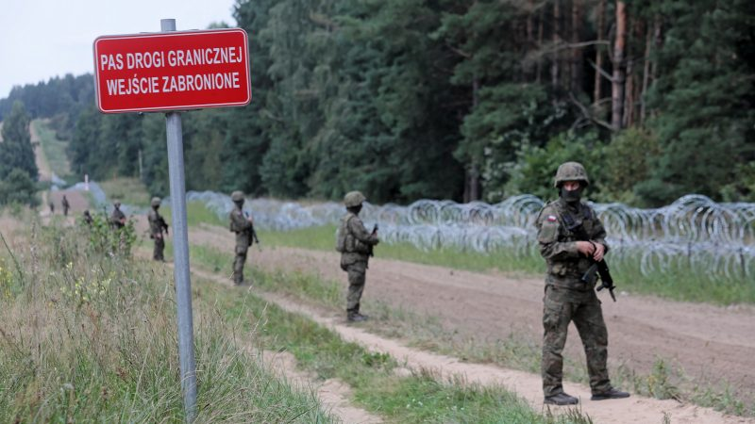
Migrants? Refugees?
Situation on Polish-belarussian borders
Refugees? Migrants? …? Who else is protected? By whom?
People fleeing Myanmar (Rohyngia minority)
Refugees? Migrants?
Syrians in Syria
Refugees? Migrants?
Receiving societies?
You will not make Australia home
We were the refugees once
„the message is simple“ – one day WE CAN BE REFUGEES

Slide 5
Refugee definition – inclusion clause
= who is a refugee
A refugee is:
outside his/her country +
owing to well-founded fear
of being persecuted
for reasons (see the next slide)
is outside the country of his nationality and is unable, or owing to such fear, is unwilling to avail himself of the protection of that country
(stateless)
for one of the reasons:
- race,
- nationality,
- religion,
membership of a particular social group,
political opinion

Slide 6
Refugee definition – cessation and exclusion clause
Cessation
to whom protection cease to apply (does not apply any longer)
….see art. 1 C Refugee Convention
Exclusion
persons receiving protection from other parts of the UN (e.g. Palestinians within UNRWA mandate) - art 1(D)
persons assimilated into the countries where they live – same rights and obligations as nationals - art 1(E)
persons who do not deserve protection - Art 1(F)
Child soldiers?

Slide 7
UNHCR
UNHCR mandate
originally mandated to lead and co-ordinate international action to protect refugees and resolve refugee problems worldwide
core mandate expanded to others
returnees
stateless
also a role in the issue of IDPs
Who are those „others“?
are they refugees from a legal point of view?
are they eligible for another type of protection?
does the law count with their situation?

Slide 8
Fleeing inside a country
IDPs
who are IDPs?
read more
Soft law: Guiding principles ….
Hard law: Kampala Convention (African regional convention)
https://guapamurcia.es/conflicto-cultural-las-migraciones/ (map probably as of 2016)

Slide 9
Fleeing from war (armed conflict)
Armed conflict:
international armed conflict (between two or more states)
non-international armed conflict (state x non-state actor, e.g. Rwanda)
War „refugees“? Are they refugees according to the Refugee Convention?

Slide 10
What type of armed conflict does the law recognize as relevant for granting protection? And what type of protection can be granted?
UNHCR – Handbook (para 164-166)
UNHCR – Guidelines
Does international law recognize people fleeing conflict as refugees?
Refugee convention?
Regional refugee frameworks?
European law

Slide 11
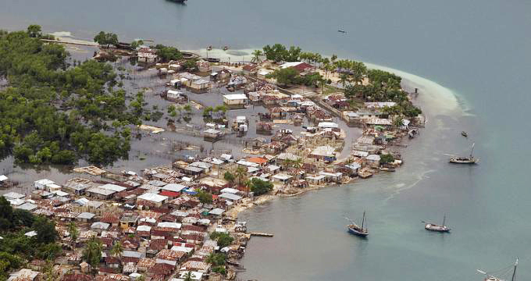
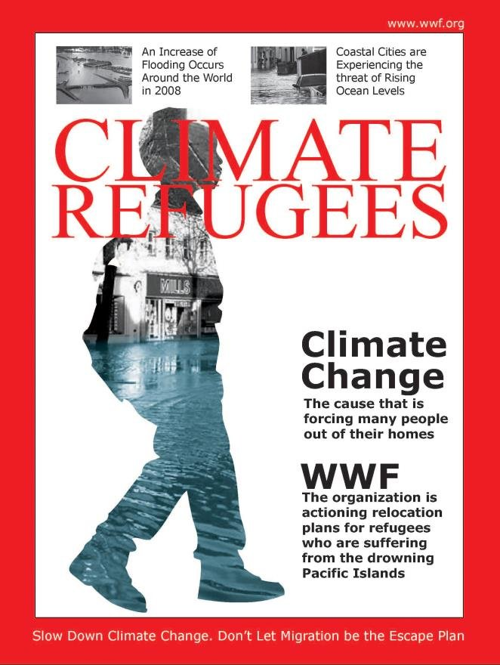
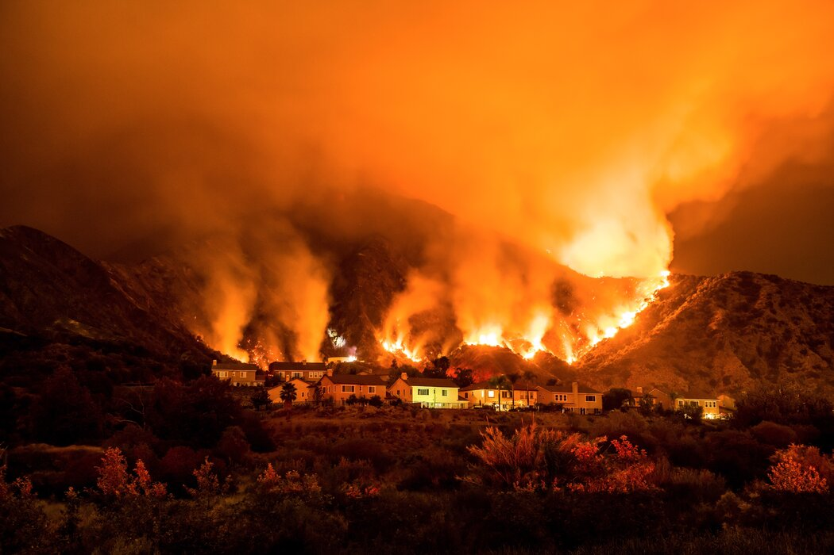
„Climate refugees“?

Slide 12
Have a look on figures!
UNHCR Global Trends
Mid Year 2021
Year 2020

Slide 13
Thank you for your attention!

